Slide 1

BeInTouch
(Social Networking App)
Topic : Social Networking
Group -7

Slide 2
INTRODUCTION
BeInTouch is a social media android app where people can join or connect with each other .
User can upload their media i.e pictures, videos..etc
Its an app where people can create their unique account and can chat with their friends.
User can see the feeds and status of their friends who are in connection.
Connecting & keeping in touch with your colleagues in all over the world.

Slide 3
Most popular Social Networking sites :
Facebook
Instagram
LinkedIn
Twitter
Snapchat

Slide 4
Objective
To build a user-interface so that user can communicate with their knowing once.
To provide a platform for connecting peoples.
User can share their real-time updates(Status) with their connections.
Users can search peoples.

Slide 5
Inputs
Sign Up Module (with phone number verification)
User have to enter their details i.e.
Name
Email
Phone
Password
Sign In Module (also with Google and Facebook API)
User have to input their login ID and password.
Reset Password Module
If user wants to reset their password then user has to
enter his Email ID .
Outputs
Status Update Module (User will see the status of his friends)
Feeds Module (User will see the posts of his friends)
Notifications Module (User can get the various notifications.)

Slide 6
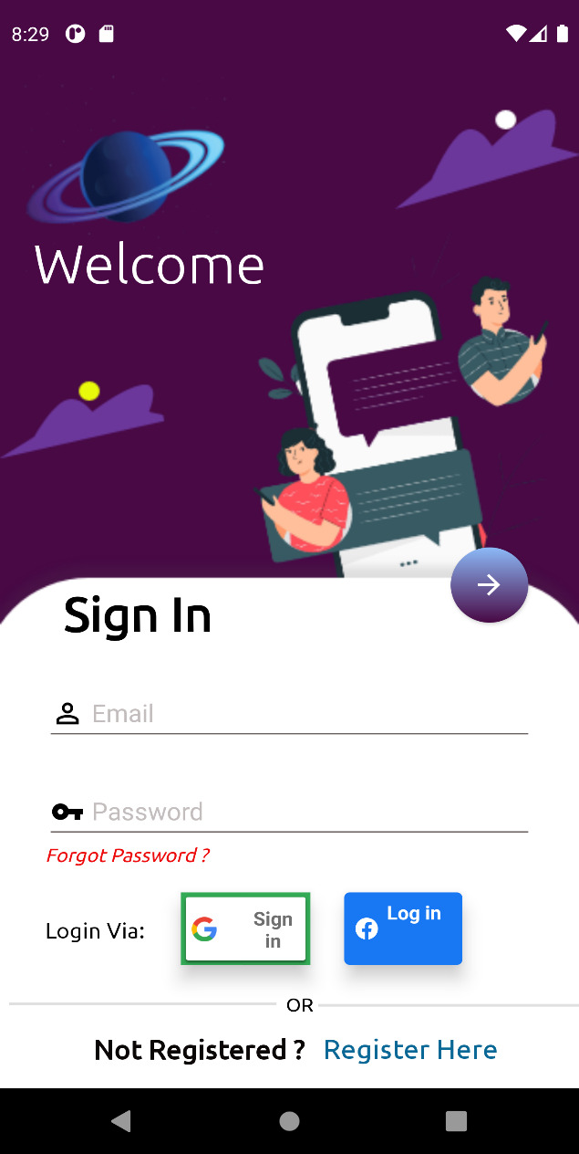
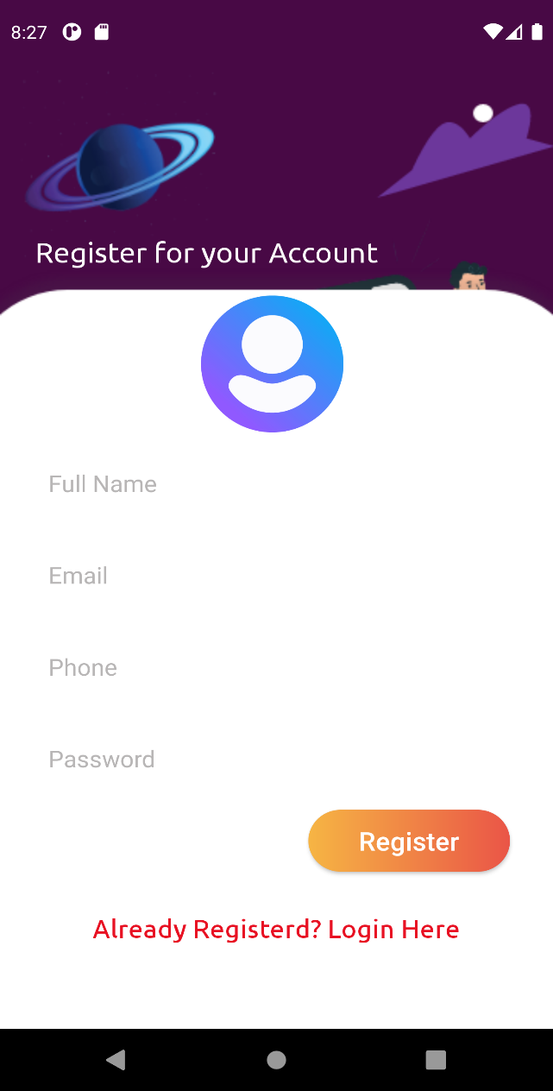
Screenshots of the App

Slide 7
Requests Module
Reels Module (Short Videos)
Chatting Module
Profile Settings Module
Search Module
Other Functional Requirements

Slide 8
Constraints
The User Interface must be good and easily accessible by users.
All Users should only login to their unique user account.
All users can see the feeds of their friends.
Users one to one chat must not be public.
All data’s like messages and posts must be updated in real time.

Slide 9
Hardware and Software Requirements
CLIENT SIDE
Android SmartPhone (5.0 Lolipop or above)
Internet service is required.
DEVELOPER SIDE (Software Requirements)
Operating System :Windows 10
Android Studio 3.6 or above
Google Firebase Server

Slide 10
THANK YOU ALL FOR WATCHING OUR PRESENTATION.

